Slide 1
ReD Shield and UPF Entitlements Integration
Tech talk Session 1
Tushar y Parate
16 Jan 2018

Slide 2
- What is APSF & CSI2 Integration? - Integration Solution Architecture - Components - Design - Session Management - Deployment
Agenda

Slide 3
ReDShield - is a multi-tenant, SAAS based, real-time fraud detection for online retailers. Shield supports over 2000 individual retailers with a throughput of 60 transactions per second (TPS). Titanium - Improve scalability of ReD Shield application through the application configurable meta data, stream computing and big data systems. - improve the cost per transaction at Red Shield
ReD Shield and Titanium

Slide 4
1. Rules Processor – processes rules and generates alerts 2. Batch Analytics Engine – computes feature values using Hadoop 3. Feature Manager 4. Rule Manager 5. List Manager 6. Stream Analytics Engine (SAE) which provides real-time computation of features. 7. Meta Data Service, a provisioning system for Events, Attributes, Features, Rules and Lists.
Components

Slide 5
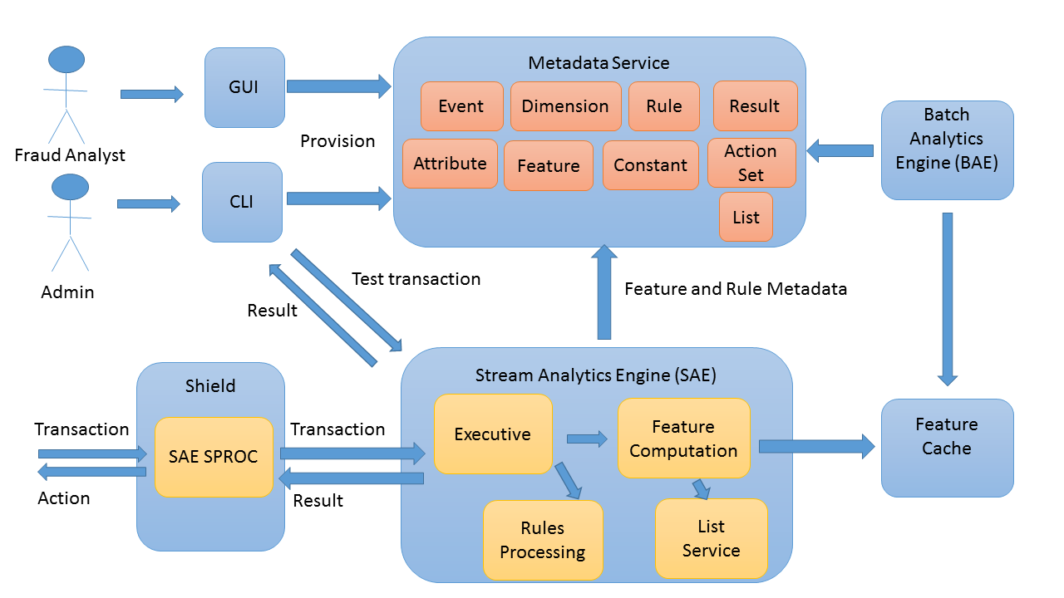
Architecture

Slide 6
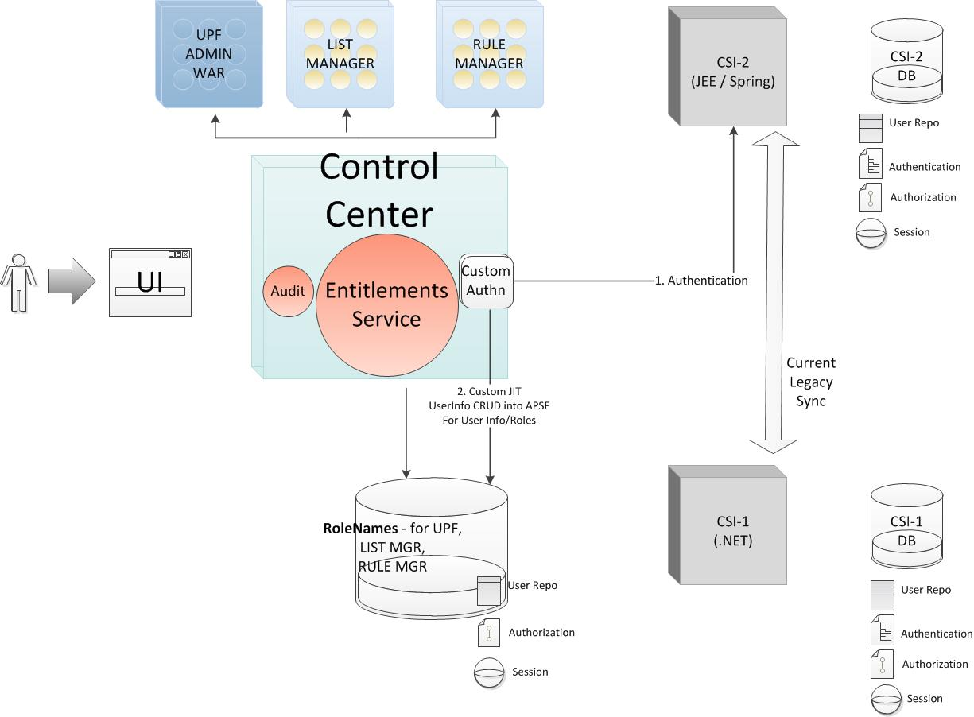
APSF & CSI2 Integration Solution Architecture

Slide 7
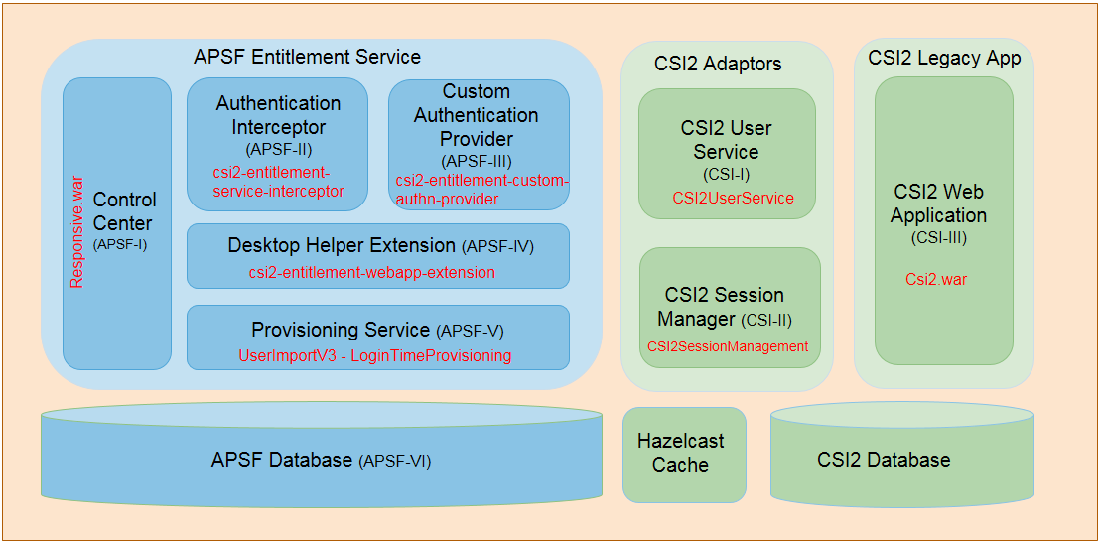
APSF & CSI2 Integration – Components

Slide 8
APSF & CSI2 Integration – Components
CSI team will provide 3 new components for integration purposes
CSI-2A BSI Interceptor:
This will intercept the BSI calls sent to entitlement provider and then perform actions to support various integration needs
This will be a new jar file that is created and deployed with entitlement service. The jar will be picked up by runtime by entitlement service and loaded in the same process as entitlement service.
CSI-2A Custom Authentication Provider:
This will be a new jar that would be created and would be configured to invoke calls to legacy authentication provider (CSI-2A)
This jar will be picked up by entitlement service as well.
CSI-2A Adaptor:
This will a new component introduced as an adaptor between entitlement service and CSI-2A.
It will provide services for authentication and session management that would be consumed by CSI-2 interceptor.

Slide 9
APSF & CSI2 Integration – Components…
4. Provisioning Service:
We are supporting just in time (JIT) provisioning in CSI2 user into APSF database.
5. Desktop Helper Extension:
This is the extension of APSF functionality to add/send session information to the browser for further user.

Slide 10
Pre-reqs
For JIT provisioning at the user level to succeed, following prereqs need to be met
Org that the user belongs to be must be added in APSF prior to user provisioning
Appropriate role definitions must be added in APSF which the user would be entitled with
Custom Authentication Provider must be installed in APSF that user will be associated with

Slide 11
Org Hierarchy for Porting
CSI-2 orgs will be ported into APSF as described in the diagram below
Root org will not be used in APSF for any business functions. This is done to enforce the best practices in terms of security.
A new org will be introduced But in terms of following best security practices, we will introducing called ReDShield that will accommodate all ACI CSR and support staff members.
Clients and Subclients belong to the same level in hierarchy in RS. Those need to be represented in separate levels in APSF.
APSF
Root (Superusers only)
ReDShield (ACI CSR)
Client
SubClient
ReD Shield
Admin Org (ACI CSR)
Client & Subclients

Slide 12
Session Management
The CSI-2 session should be created at the time of initial login when the BSI call is made to CSI2Authentication service.
The session handle should be returned as part of the response from BSI service CSI2Authentication service.
The BSI interceptor added for login BSI call should then add the extended attribute on user object that is built and returned as part of the login BSI call. So that caller has CSI-2A session info.
The caller of BSI call happens to be doLogin() method inside DesktopHandler class. It has access to HTTPrequest. The CSI-2 session information then should be added as a separate cookie for future use with following caveat
Cookie should be written at the “root” path that is available to CSI-2 app
It is a cross domain cookie and needs to be properly secured
It is recommended to use HTTP only cookie with secure signing

Slide 13
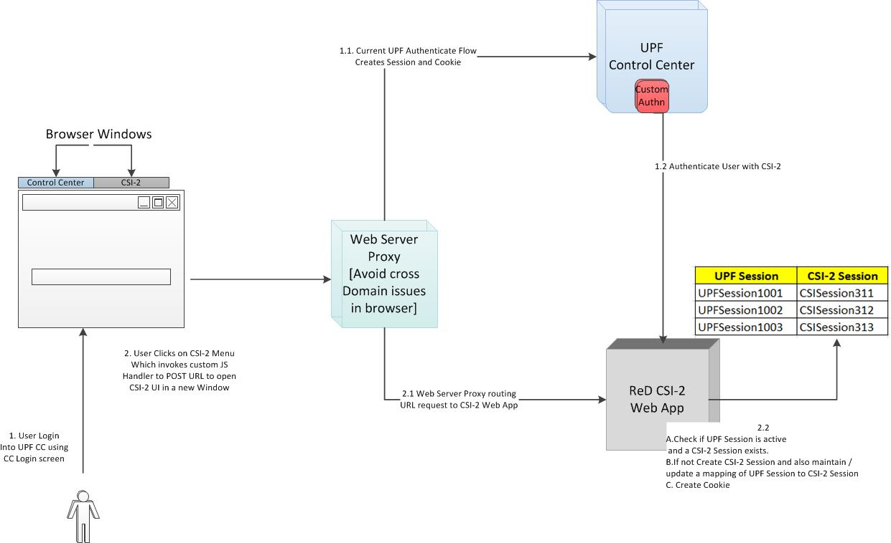
Integration Flow

Slide 14
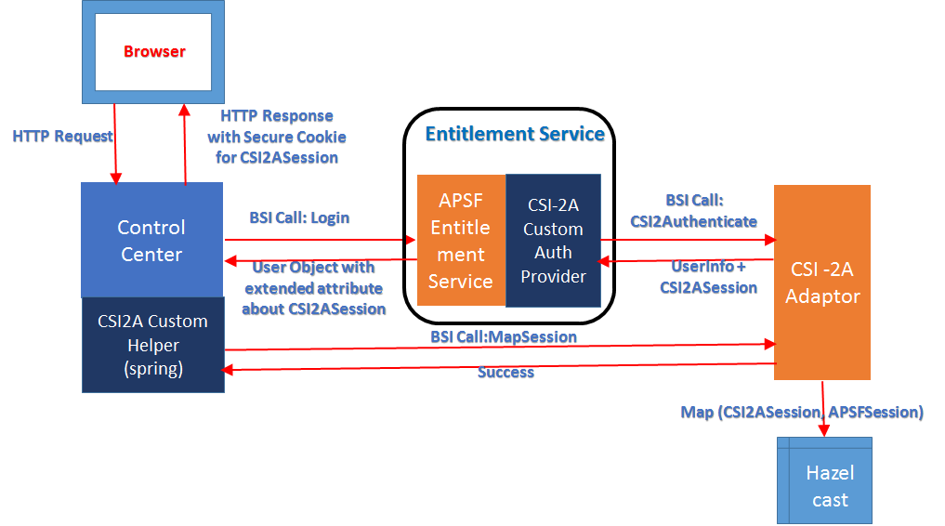
Session Mapping Flow
Make a call from the Custom Helper to map the session

Slide 15
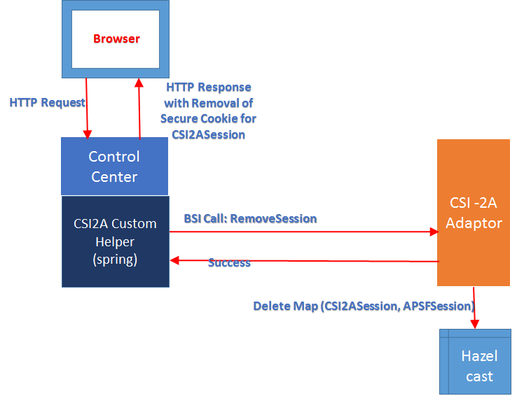
Session Removal Flow
When entitlement session goes away, CC doLogout method is trapped as well.
We can use this mechanism to obsolete CSI2A Session

Slide 16
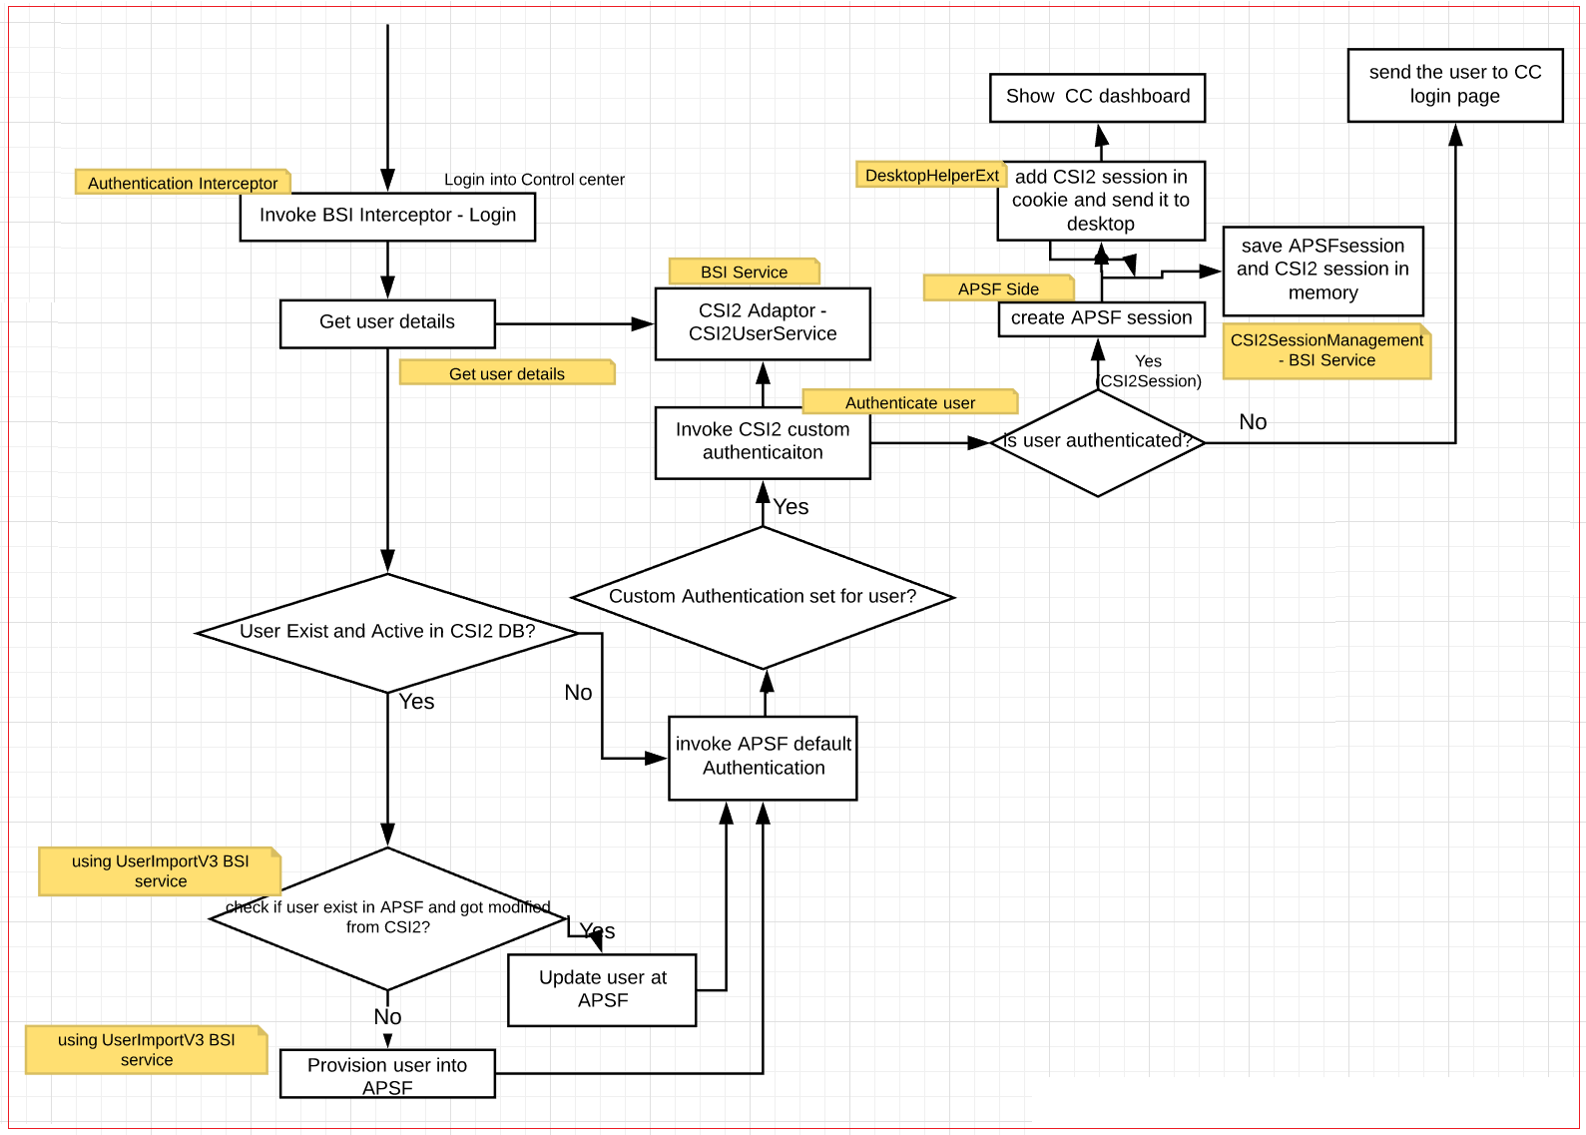
Entitlements – Authentication Flow

Slide 17
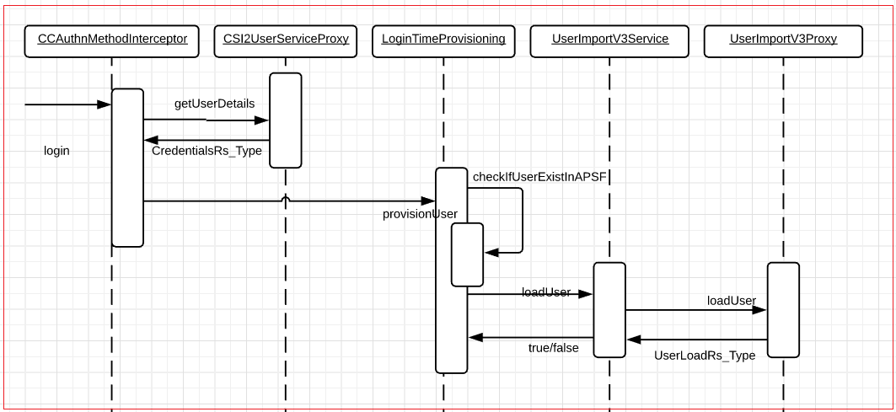
Sequence Diagram – Interceptor and Provisioning

Slide 18
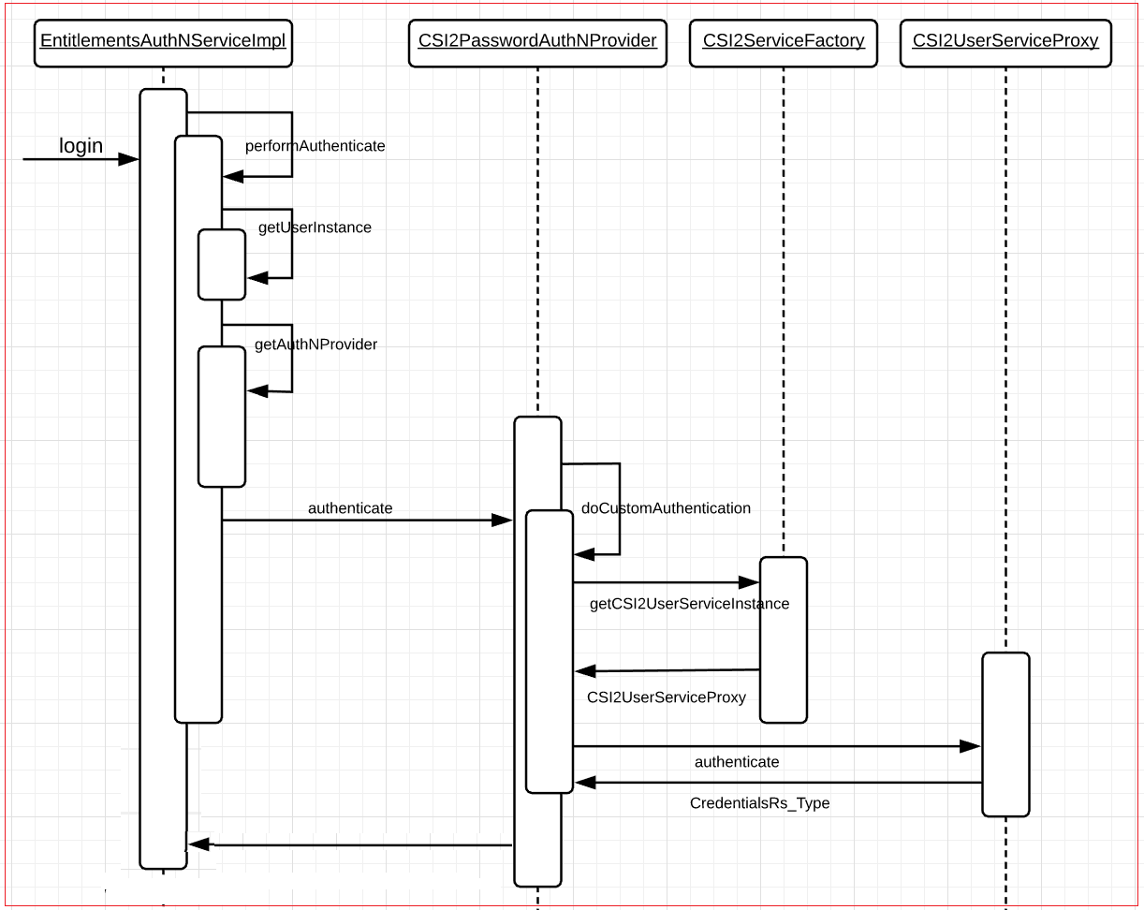
Sequence Diagram – Custom Authentication

Slide 19
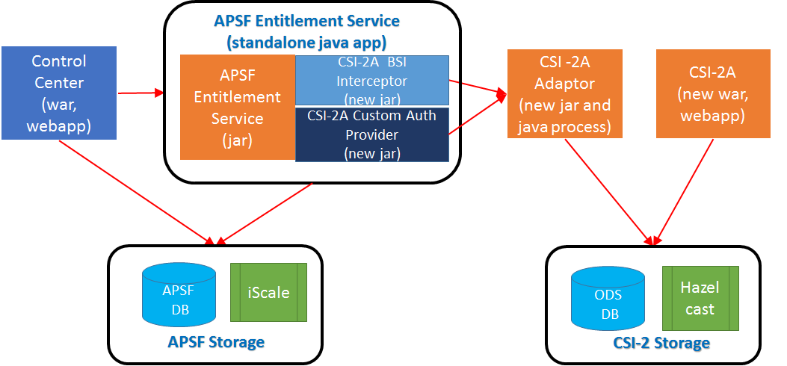
Deployment Approach

Slide 20
APSF Deliverables: Build vs Use
The following APSF artifacts would be incorporated in RS solution
Entitlement Service
Responsive webapp (Control Center)
Admin Ops webapp
Those components need to be updated for the following reasons
Adding menus
Changing config to allow custom plugins/jars to be picked up
This could be accomplished one the 2 ways
Option 1: Get the source code, build and package it ourselves
Option 2: Get the artifacts (war or jar file), update the content by adding or replacing files in it.
The RS team would be using option #2.

Slide 21
Thank you !!

